Slide 1
TEAM5OAGS Online Art Gallery System PRESENTATION Spring 2013

Slide 2
Team Roster
Ryan Lee – Team Leader
Christopher Cruz – SQA
Muhammad Naviwala – SQA
Gabriel Ohlson – DBA
Joel Loucks – DBA
Matthew Liang – Team Member
Christopher Berkowitz – Team Member
Yash Jaradi – Team Member

Slide 3
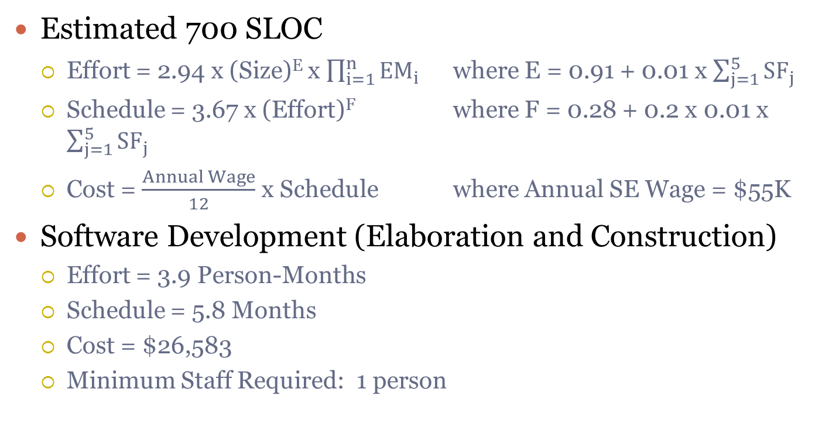
COCOMO II Estimates
Estimated 700 SLOC
Effort = 2.94 x (Size)^{E} x $\prod_{i=1}^{n}{EM_{i}}$ where E = 0.91 + 0.01 x $\sum_{j=1}^{5}{SF_{j}}$
Schedule = 3.67 x (Effort)^{F} where F = 0.28 + 0.2 x 0.01 x $\sum_{j=1}^{5}{SF_{j}}$
Cost = $\frac{Annual Wage}{12}$ x Schedule where Annual SE Wage = $55K
Software Development (Elaboration and Construction)
Effort = 3.9 Person-Months
Schedule = 5.8 Months
Cost = $26,583
Minimum Staff Required: 1 person

Slide 4
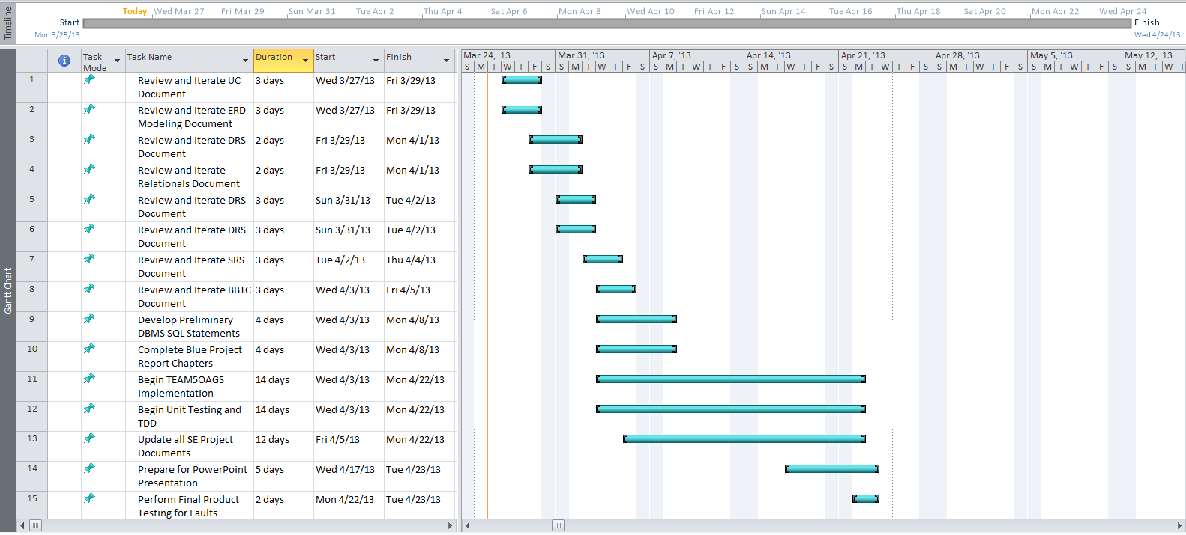
Microsoft Project Estimates

Slide 5
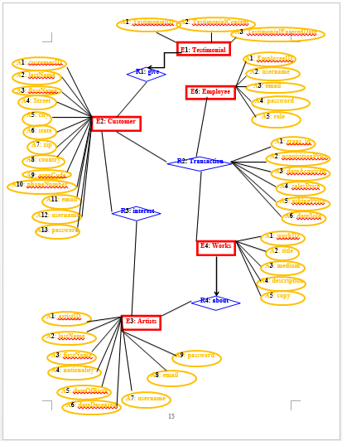
ERD Diagram

Slide 6
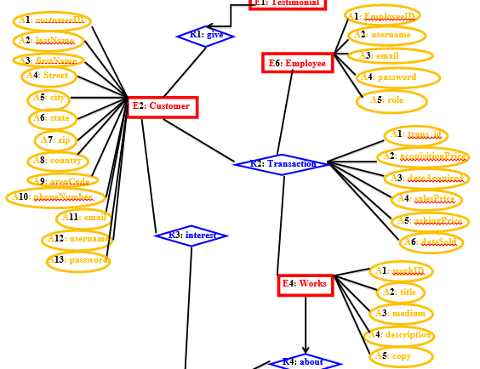
Customer “Purchase” Artwork ERD Model

Slide 7
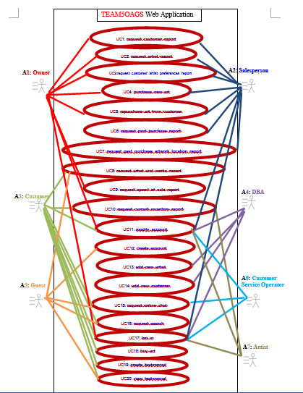
UC Diagram
Notes:
Total of 20 Use Cases

Slide 8
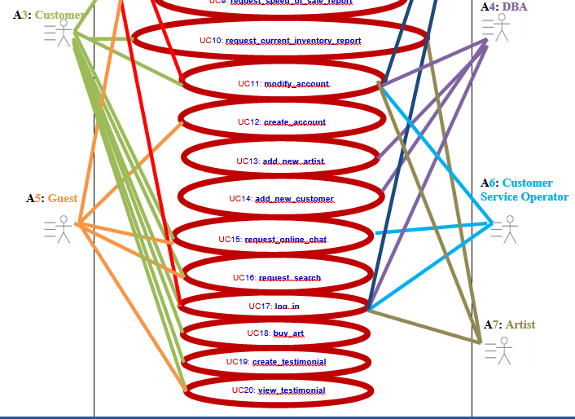
Customer “Purchase” Artwork UC Model

Slide 9
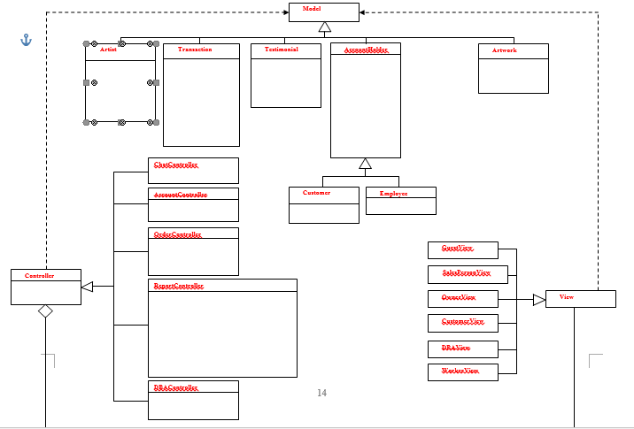
OOA Class Diagram

